Slide 1





Erasmus Mundus Joint Master
www.master-cde.eu

Slide 2
Invitation for Student Sponsorship
Become an ambassador to this unique postgraduate study programme where the potential of Copernicus data and information for education & research are fully exploited in use cases, collaborative research work placements or internships, and in Master‘s Theses research projects.
We offer an outstanding and distinctive Erasmus Mundus Joint Master (double degree) experience to our graduate students

Slide 3

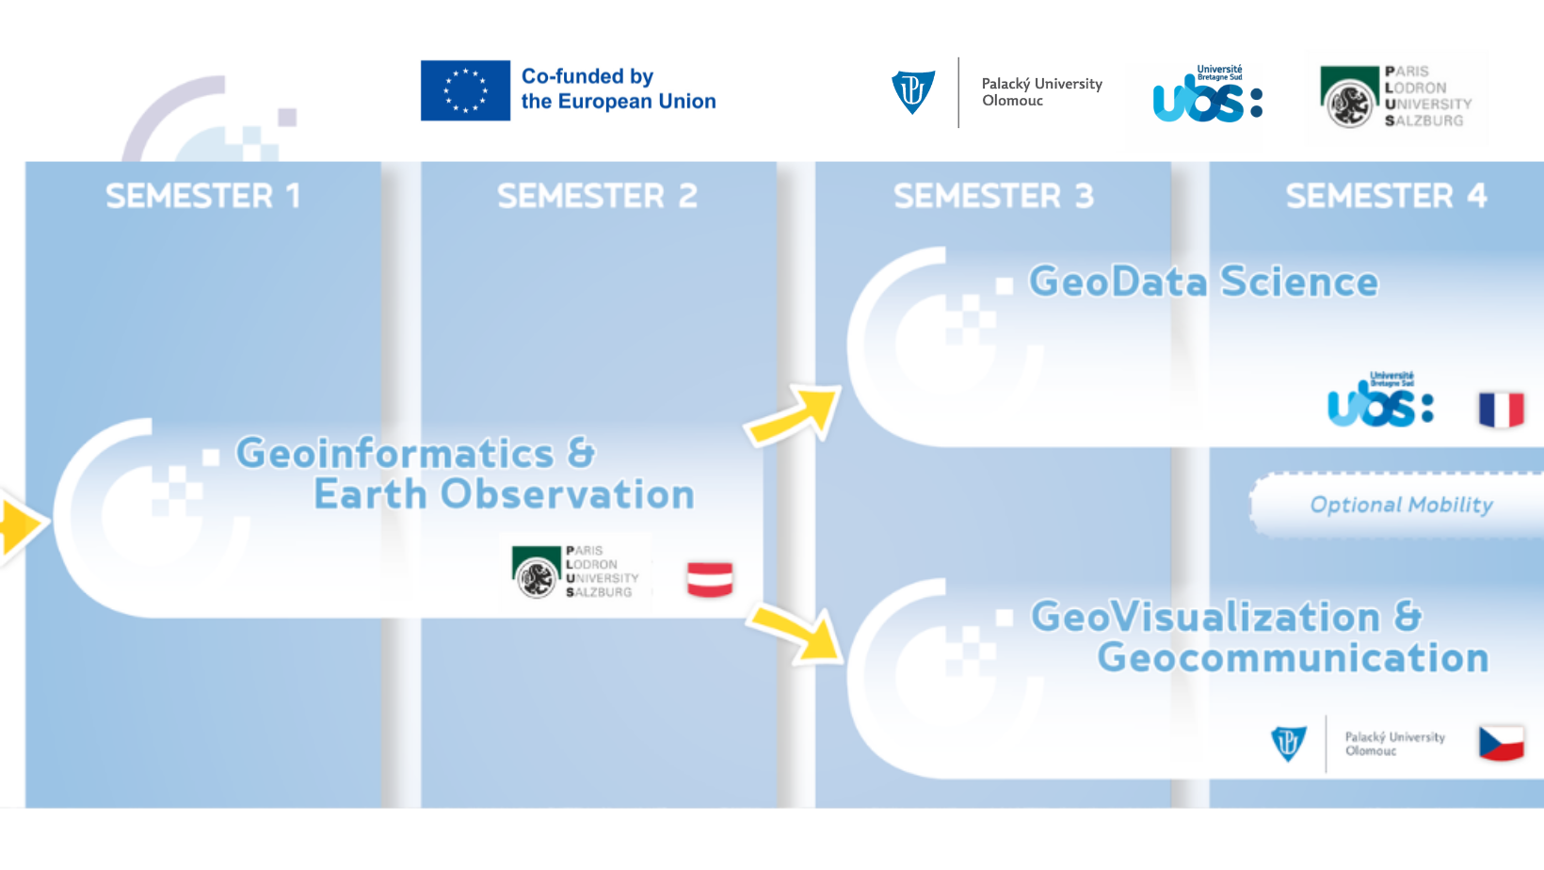
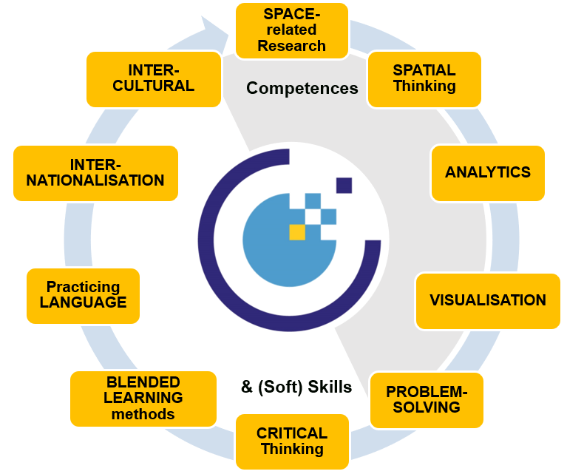
Erasmus Mundus Joint Master
Key required EO*GI competences & skills of students enhance the employability of alumni worldwide,
in Europe’s space industry & the downstream sector.
Co-funded by the European Union
www.master.cde.eu
Erasmus Mundus Joint Master

Slide 4
Sponsorship options
PLATIN SPONSOR
EUR 29.000,-
GOLD SPONSOR
EUR 15.000,-
SILVER SPONSOR
EUR 12.000,-
BRONZE SPONSOR
EUR 5.000,-
The Platin sponsorship amounts to EUR 29.000,- and covers estimated living and travel costs for two years. The Gold sponsorship of EUR 15.000.- is a contribution to one year living and travel costs.
The Silver sponsorship amounts to EUR 12.000,- and supports one year of living costs.
The Bronze sponsorship, EUR 5.000,- is a contribution to travel costs for two years.
https://master-cde.eu/costs-funds/sponsorship

Slide 5
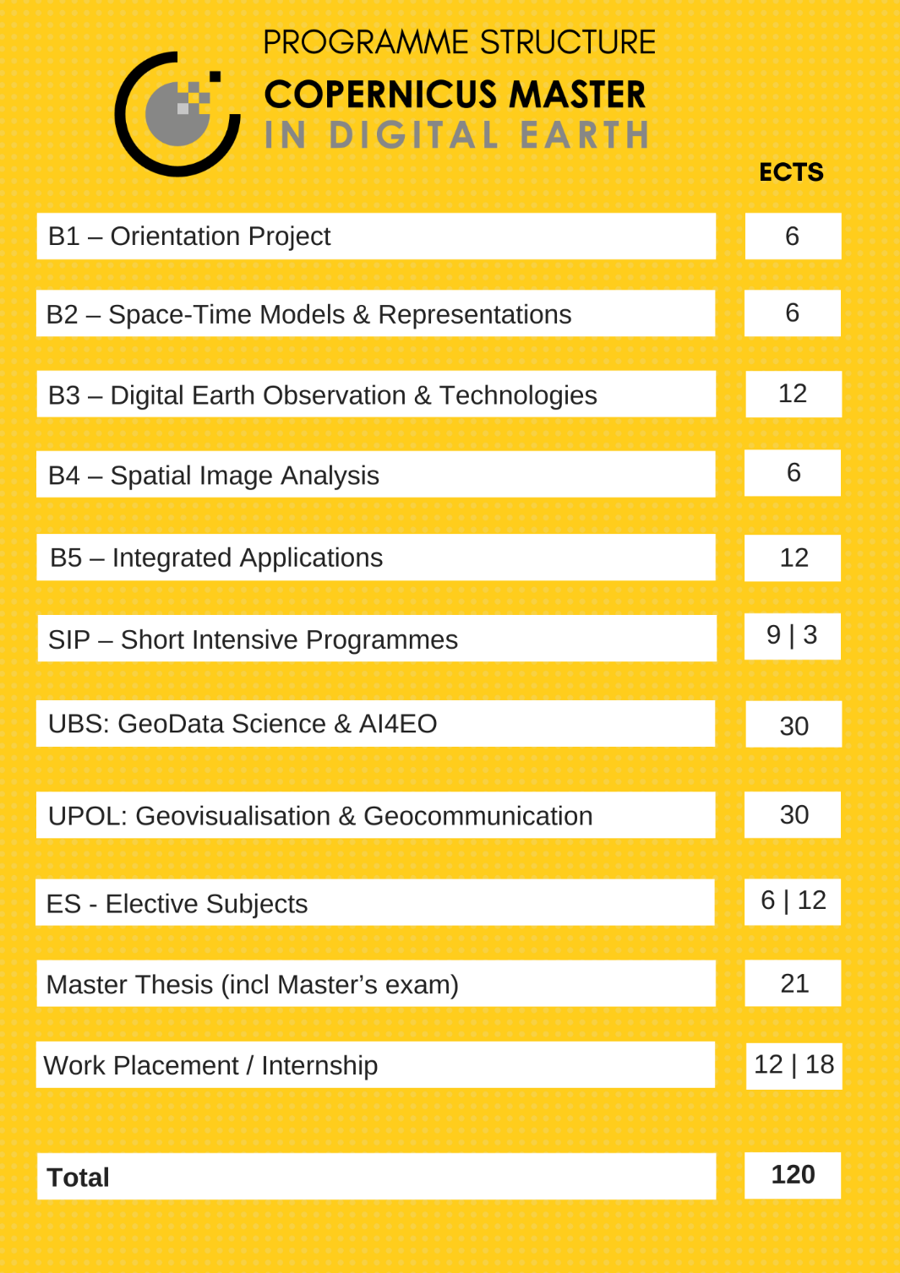
Erasmus Mundus Joint Master of Science
Co-funded by the European Union

Slide 6
Compuslory student work placements
Skills based internships
Collaborative Research
Work Placement
Practical at
industry or research
8 weeks
Option to work on Master’s Thesis & joint publication
Master‘s Thesis research at industry or research
12 – 16 weeks
Master’s Thesis & joint publication
Co-funded by the European Union

Slide 7
Skills-based internships
Learning Objectives
skills-based internships
gain experience and insights through practical work
implement knowledge in real world cases
employ and develop new skills and abilities
experiment, translate knowledge and skills to achieve set goals
cultivate a professional network and engage outside
Co-funded by the European Union

Slide 8
Collaborative research work placement
Learning Objectives
collaborative research
work placement
gain experience and insights through practical work
implement knowledge in real world cases
employ and develop new skills and abilities
experiment, translate knowledge and skills to achieve set goals
design and develop Master's Thesis research
plan and draft a research publication jointly with supervisors
cultivate a professional network and engage outside
write Master's Thesis
Co-funded by the European Union
Notes:
- provide the student with an integrative research focused work placement experience for the duration of a maximum of one semester
- this research shall lead to a Master’s Thesis jointly supervised by CDE faculty and a scientist working in the industry

Slide 9
ISCED 7
EO*GI Scientists postgraduate education
Student Master‘s Thesis
The study programme is challenge- and research-driven, provides a broad range of academic analysis and scientific methods, and prepares students for a doctoral degree programme.
It corresponds to International Standard Classification of Education (ISCED 2011): level 7, European Qualification Framework (EQF), and National Qualification Framework (NQR): level 7.
  CDE graduates are confident in using key technologies pertinent to spatial information handling & upcoming trends in the field of Copernicus & Digital Earth.
  Answer research questions, including the development of hypotheses, definition of objectives, selection of methods, implementation of workflows, collection, analysis & interpretation of data as well as a written & oral communication & interpretation of outcomes in a decision support context.
Notes:
Two complementary and increasingly converging sectors, Earth Observation and Geoinformation (EO*GI), by considering the needs for ‘Copernicus’ experts in the fields Space, Geo, Information aiming to reach beyond a technologist / analyst profile and extend from management to leadership.
The study programme covers all areas of geospatial data collection and data management, spatial analytics, communication of results and decision support, interaction with spatial information, as well as aspects of research management and excellent mastery of methodical and interpersonal skills.
Alumni have profound EO*GI application-oriented expertise based on relevant theories & methods.
Specialized in Geovisualisation, Geocommunication & application development, including Cartography & design, Web & cognitive Cartography, 3D & advanced visualisation methods.
Specialized in Computer Science/GeoData Science including computer vision, machine learning and big data with a focus on data analytics for Earth Observation

Slide 10
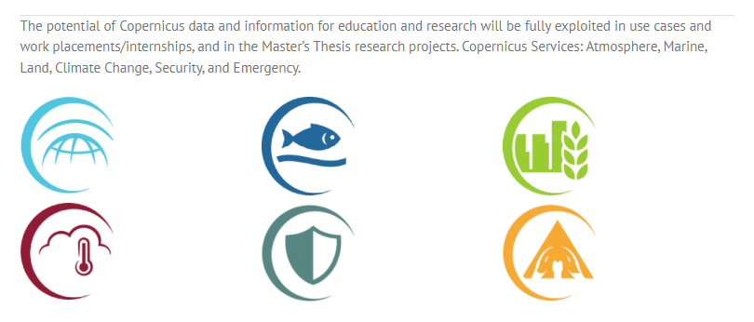
Student Master‘s Thesis topics
Completed during semester 4
Co-supervised by academic faculty from at least
two different universities, and partners
The Master’s Thesis serves to demonstrate that
students have acquired the ability to perform
independent academic research in the area of
Earth Observation and Geoinformatics
according to current academic research methods and standards
Submitted in English language

Slide 11

Programme & Project Management
Stefan Lang
Joint Programme Coordinator
& Academic Lead
Barbara Schernthanner-Hofer
Programme Board
Dirk Tiede
Programme Board
Barbara Brunner-Maresch
Project Management & Student support
Department of Geoinformatics
Earth Observation & Geoinformatics
B1 - Orientation Project
B2 - Space-Time Models & Representations
B3 - Digital Earth Observation & Technologies
B4 - Spatial Image Analysis
B5 - Integrated Applications
Co-funded by the European Union

Slide 12

Programme & Project Management
Vít Vozenílek
Programme & Selection Committe Chair
Alena Vondráková
Programme Board
Dana Gronychová
Coordinator of International Mobility
Jakub Koníček
Student support
Department of Geoinformatics
Geovisualisation & Geocommunication
Geovisualisation
  Systematic Geovisualisation
  Advanced Methods of Geovisualisation
  Design in Geovisualisation
Geocommunication
  Cognitive Cartography
  Web Cartography
Electives
Co-funded by the European Union

Slide 13
Programme & Project Management
Sébastien Lefèvre Programme & Selection Committe Co-Chair
Charlotte Pelletier
Programme Board
Sandra Vessier
Head of International Office
Pernelle Blaise
Student support
Computer Science Department
GeoData Science & AI4EO
Fundamentals of Data Science
  Machine Learning
  Foundations of Deep Learning
  Big Data
Artificial Intelligence for Earth Observation
  Efficient Remote Sensing Image Processing
  Deep Learning for Computer Vision
  Geospatial Data Analytics Project
Co-funded by the European Union
www.master.cde.eu
Erasmus Mundus Joint Master

Slide 14
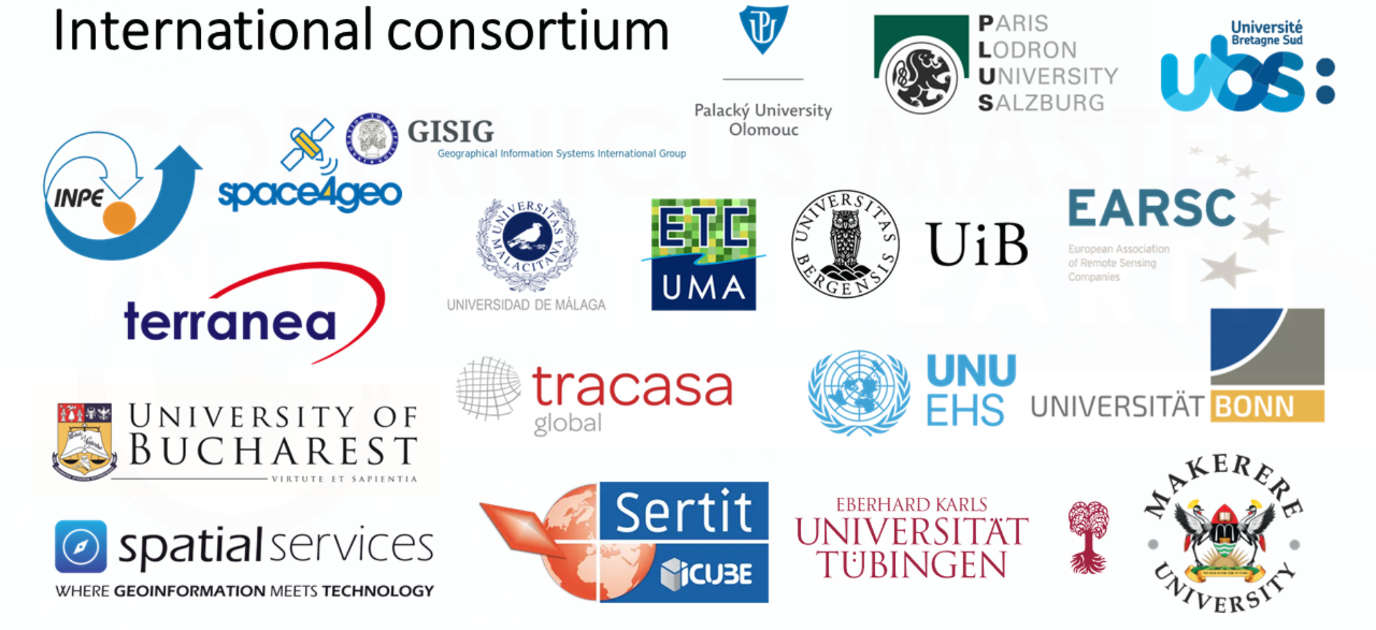

Slide 15
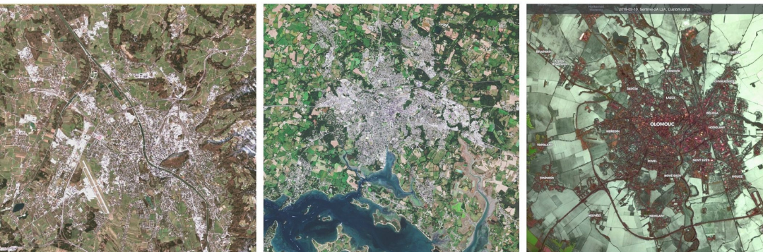

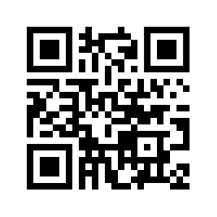
Contact
Paris-Lodron University Salzburg Department of Geoinformatics
Schillerstrasse 30
5020 Salzburg
Austria
47.82380499847819, 13.039431310898214
Project & Programme Office
Email: msc-cde@plus.ac.at
www.master-cde.eu
Erasmus Mundus Joint Master

Slide 16

Co-funded by the European Union
The European Commission support for the production of this publication does not constitute endorsement of the contents which reflects the views only of the authors, and the Commission cannot be held responsible for any use which may be made of the information contained therein.

